Slide 1

Chess Blitz Champions
Nikhil Pandeti
Nvp293
Nikhil.Pandeti@gmail.com

Slide 2
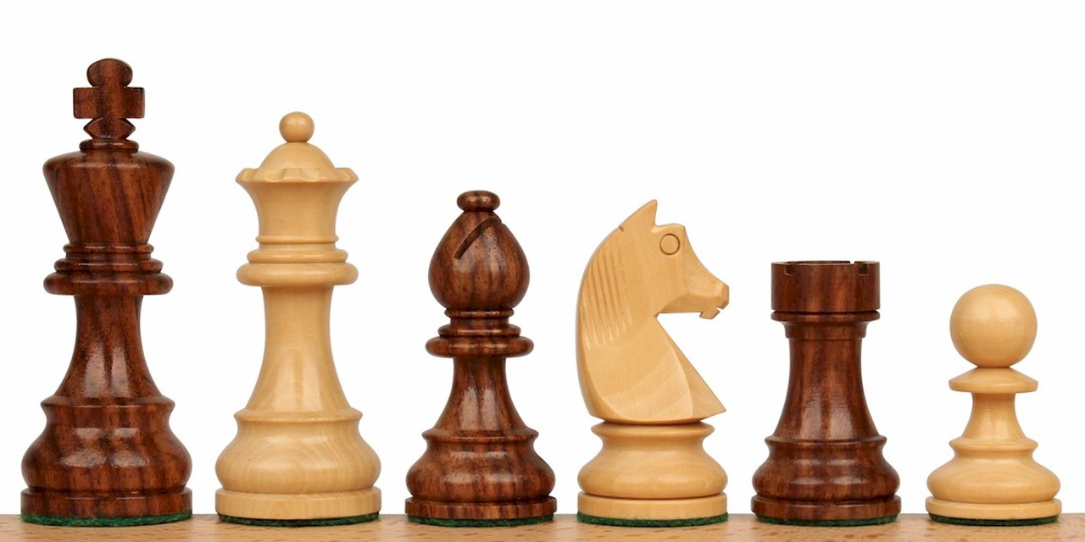
What is Chess Blitz Champions?
Chess Blitz Champions is a mobile online multiplayer chess game with a blitz style 10 minutes of thinking time for each player. Each game is match made using an in-game ELO rating system to create a competitive and fun atmosphere for each player by pitting them against opponents of similar skill level.

Slide 3

Major Subsystems
User Account Registration/Login
Game Home Page and Menu
Game Board with Chess Clock
Chess game logic
Match making engine
Online Multiplayer
ELO Rating System
Settings

Slide 4

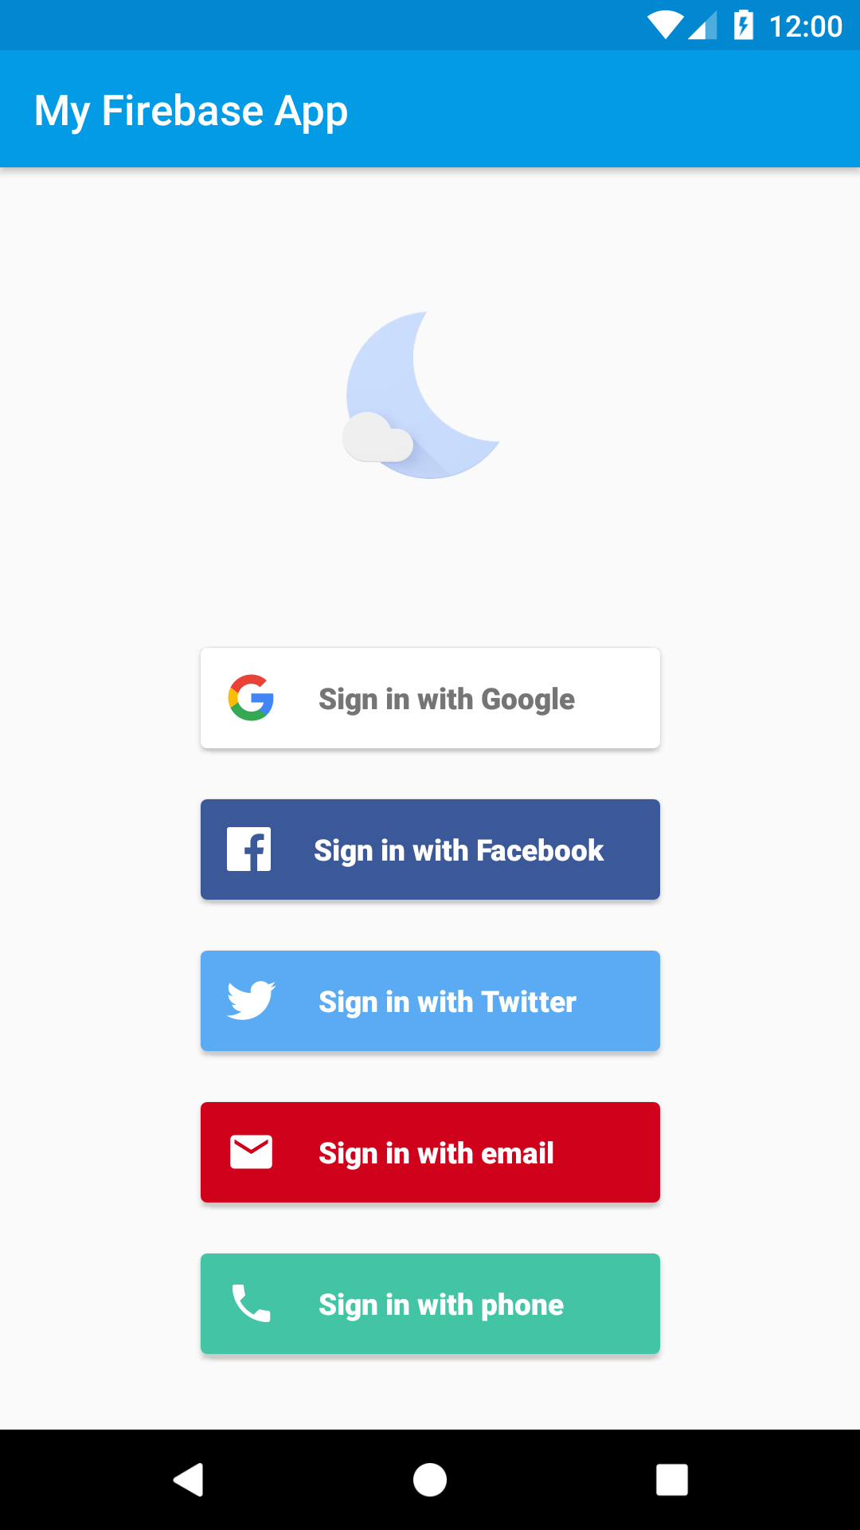
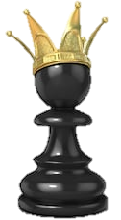
Login
Chess Blitz Champions

Slide 5

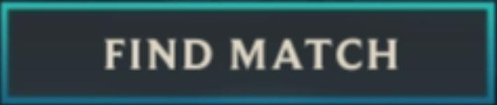
Home
Chess Blitz Champions
Welcome Back, Player1
ELO: 1000
Wins: 123

Slide 6
Settings
Chess Blitz Champions
Blitzer ID:
GamerBoi420

Slide 7
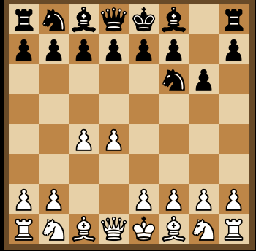
Game
Chess Blitz Champions
GamerBoi420
ELO: 950
7:49
Player1
ELO: 1000
6:32

Slide 8

Results
Chess Blitz Champions
GamerBoi420
ELO: 950
7:49
YOU WON!!!
+21 ELO
Player1
ELO: 1000
6:32

Slide 9
Week By Week
Oct 29 – Nov 5: Menu Layout, Home Layout, Firebase Login, Settings Layout
Nov 5 – Nov 12: Game Screen Layout, Chess Board and Pieces, Chess game logic + Chess clock
Nov 12 – Nov 19: Create Firebase Realtime Database and implement Multiplayer events
Nov 19 – Nov 26: ELO Ranking System and Matchmaking System
Nov 26 – Dec 3: Win/Lose Result Popup + Bug Fixes

Slide 10
APIs I’ll be Using
Firebase Authentication
Firebase Realtime Database

Slide 11
Functional Spec for TA on 11/15
Login/Register with Facebook, Twitter, email, and phone
Home Layout with user display name and buttons for Find Game and Settings
Settings Layout with edit display name functionality
Chess board Layout with local two player functionality
Pieces move
Checkmate
Draw
Working 10-minute chess clock that starts and stops according to player moves. Game ends if time runs out

Slide 12
Inspiration
I was inspired by the hundreds of existing mobile chess apps.
Most of the functionality is very standard.

